Slide 1
Case Study 1: Laryngoscope Trial
PubH 7465: Biostatistical Consulting
Spring 2024
Ann Brearley

Slide 2
Acknowledgement
The laryngoscope dataset, data dictionary and dataset introduction were obtained from the ASA’s TSHS Resources Portal.
Amy S. Nowacki, “Laryngoscope Dataset”, TSHS Resources Portal (2017). Available at https://www.causeweb.org/tshs/laryngoscope/.
Background slides were created based on the dataset introduction, by Ann Brearley.

Slide 3
Terminology
A tracheal tube is a catheter that is inserted into the trachea for the primary purpose of establishing and maintaining a patent (open and unobstructed) airway. Tracheal tubes are frequently used for airway management in the settings of general anesthesia, critical care, mechanical ventilation and emergency medicine. (1)
Direct laryngoscopy is the use of the laryngoscope to visualize the vocal cords (larynx) under direct vision, usually to facilitate endotracheal intubation. (2)
The tracheal tube is inserted through the glottis, the opening between the vocal cords, after the patient is anesthetized.
(1) https://en.wikipedia.org/wiki/Tracheal_intubation
(2) https://lifeinthefastlane.com/ccc/direct-laryngoscopy/

Slide 4
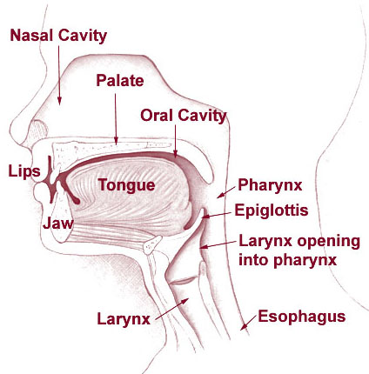
Source: https://training.seer.cancer.gov/head-neck/anatomy/overview.html

Slide 5
https://www.rchsd.org/health-articles/laryngoscopy/

Slide 6
Motivation for the Trial
Difficult and failed tracheal intubations are among the principal causes of anesthetic-related mortality and morbidity. Because a good laryngeal view facilitates successful tracheal intubation, new technologies have been introduced to improve visualization. Video laryngoscopes, for example, often use miniature cameras to facilitate visualization of the laryngeal inlet with no need to align the oral, pharyngeal, and tracheal axes.

Slide 7
Pentax AWS
The Pentax AWS [airway scope] is a novel video laryngoscope, available in Japan since 2006, which is designed to facilitate intubation by providing a video image of the glottis. It incorporates a miniature video camera and a battery-powered, built-in LCD monitor. A disposable blade is attached to the base system. Incorporation of an LCD display makes it possible to view the glottis simultaneously with insertion of the endotracheal tube (ETT). In this regard, it differs from some other video laryngoscope designs that use external monitors. The Pentax AWS also differs in having a side channel that positions and guides the ETT. Reports suggest that the Pentax AWS can help intubate, but randomized data remain sparse.

Slide 8
Study Objective and Design
This study tested the hypothesis that intubation with the Pentax AWS would be easier and faster than with a standard Macintosh laryngoscope with a #4 blade.
The study was designed as a randomized controlled trial.

Slide 9
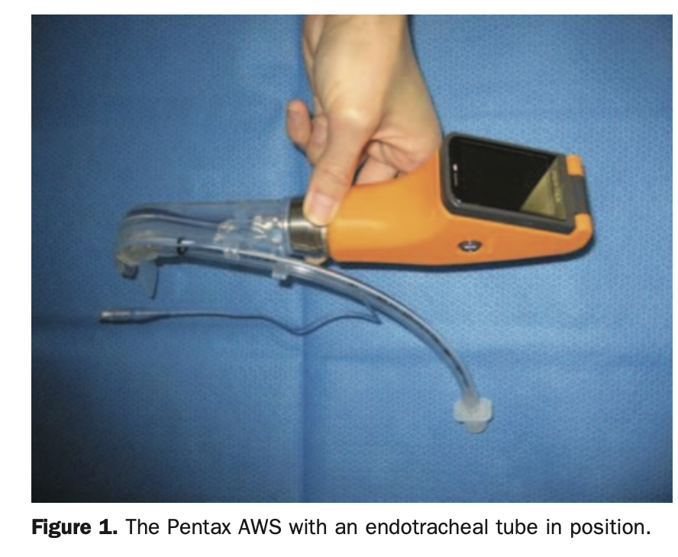
Pentax AWS and standard Macintosh laryngoscope
Abdallah R, Galway U, You J, Kurz A, Sessler DI, Doyle DJ. A randomized comparison between the Pentax AWS video laryngoscope and the Macintosh laryngoscope in morbidly obese patients.

Slide 10
Subjects = 99
The fraction of obese and morbidly obese patients is rapidly increasing worldwide. Tracheal intubation can be difficult in these patients because the limited oropharyngeal space may impede adequate visualization. Thus it was decided to test the laryngoscope performance on patient cases for whom the most technology benefit would be anticipated.
The study enrolled patients with a body mass index between 30 and 50 kg/m2 who required orotracheal intubation for elective surgery. After oxygen administration and induction of general anesthesia, patients were randomly allocated to intubation using either a conventional Macintosh laryngoscope size 4 blade (Macintosh group, n = 49) or the Pentax AWS (Pentax group, n = 50). Of 105 randomized patients, 4 did not complete the study because of cancellation of surgery or because the laryngoscopist could not arrive to the operating room on time, and 2 patients in the Pentax group had missing primary outcomes. Thus, data is available for the 99 patients who were analyzed.

Slide 11
Variables = 22
The primary outcome of time to intubation was defined as time from start of the first attempt of the insertion of the laryngoscope until a capnogram [C0₂ monitoring] signal was obtained. If an attempt with the assigned device failed, then another attempt or an alternate technique was used. Intubation using the assigned method within 100 seconds regardless of number of attempts was considered successful. For patients who crossed over to the other method or whose tracheas were intubated after 100 seconds, time to intubation was censored at that technique crossing point or 100 seconds, and labeled as a failure in the analysis.
The glottic view for each laryngoscopy was graded using the Cormack-Lehane grading system. The ease of tracheal intubation on a Likert scale (from 0 = extremely easy to 100 = extremely difficult), the presence of any blood staining, and the severity of any postoperative sore throat were also recorded during a postoperative visit the following day by observers unaware of the intubation method.

Slide 12
Case Study 1: Statistical Analysis Plan Assignment
Write a ~1 page statistical analysis plan (SAP) to address the research question for the laryngoscope trial: Is intubation with the Pentax AWS easier and faster than with a standard Macintosh laryngoscope with a #4 blade?
Part 1
Write your statistical analysis plan (following the grading rubric given in the Canvas assignment) and upload it to Canvas by noon this Friday. I will review the plans and provide comments and suggestions over the weekend. They will be graded as satisfactory or not satisfactory.
Part 2
We will discuss the SAP’s in class next Monday. Be prepared to explain the choices you made.

Slide 13
Resources (in Canvas)
This background presentation
The data dictionary for the laryngoscope trial
A description of a statistical analysis plan
The grading rubric for the Case Study 1 SAP assignment
Next week, we will give you access to the dataset from this study. Your assignment next week will be to carry out your planned analysis to address the research question for the laryngoscope trial, then write a complete analysis report.

